Slide 1
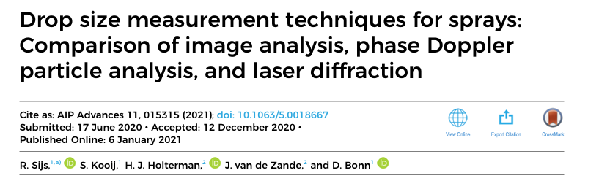
ABBAS ZAFAR
11/27/2024

Slide 2
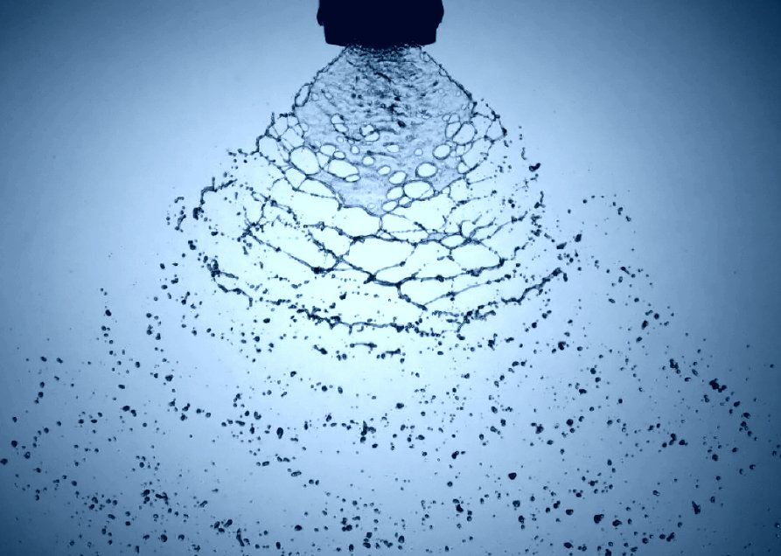
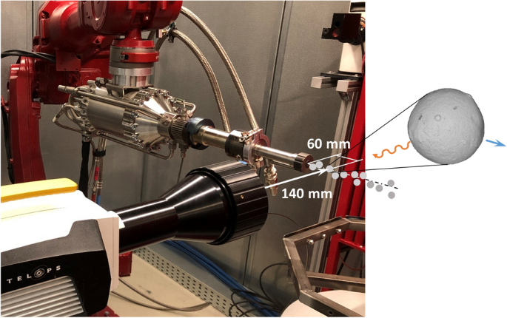
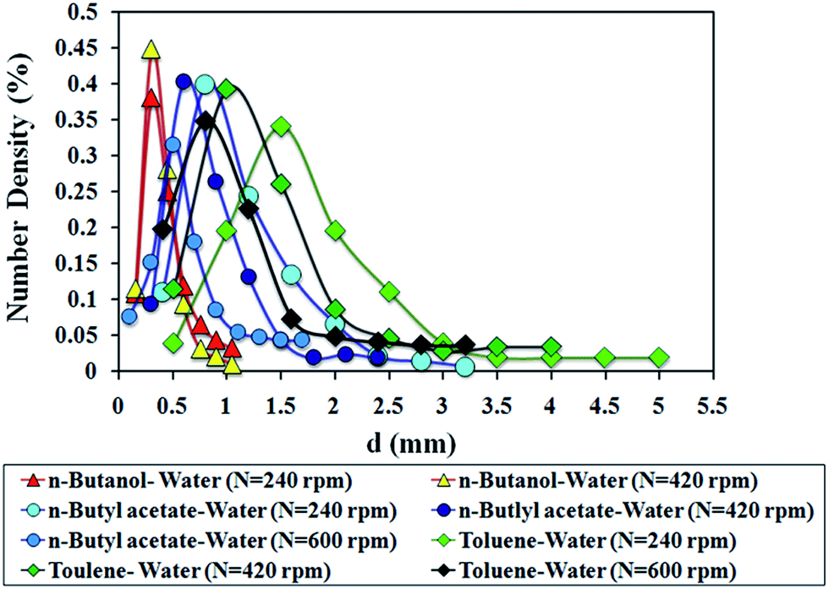
What is Spray and Atomization?
Spray: A spray is a collection of liquid droplets dispersed in air or gas.
Common examples: mist from a perfume bottle, pesticide spraying, or even fuel injection in engines.
Atomization: The process of breaking a liquid into small droplets.
Atomization Increases surface of area for better interaction.
What is Size Distribution?
Describes the variation in sizes of droplets in a spray. Important because the performance of a spray depends on its droplet size
Spray Diagnostics: The process of analyzing spray characteristics (such as droplet size, velocity, distribution) to improve design and efficiency.

Slide 3
INTRODUCTION:
Importance of Droplet Size Measurement
Applications:
Spread of infectious diseases (e.g., SARS, influenza) – droplet size affects travel distance and infection risk.
Spray applications: agriculture (pesticides), inkjet printing, de-icing, spray painting, firefighting, drug delivery.
Objective of Study
Compare three widely used techniques to measure droplet size:
Image Analysis
Phase Doppler Particle Analysis (PDPA)
Laser Diffraction

Slide 4
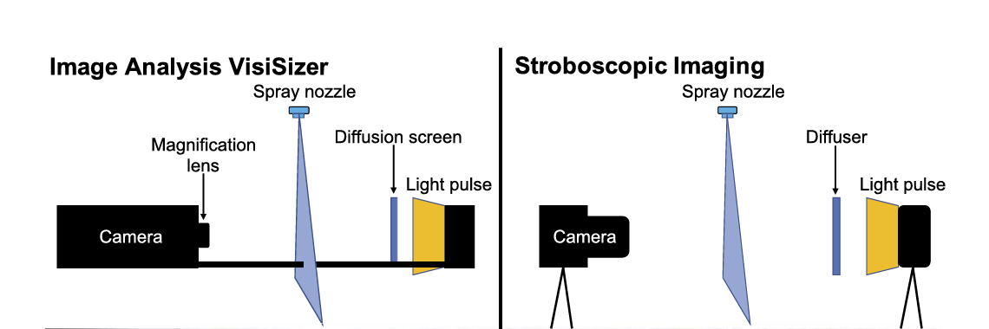
Overview of Techniques
Image Analysis:
Uses light to capture droplet images and analyze sizes.
Can determine droplet velocities through sequential snapshots.
Provides spatial distributions.
Notes:
1.A short light pulse illuminates a screen, creating a high-contrast image where the droplets appear as dark spots.
2.A camera then captures these images.
3.Software analyzes the images to measure the size and velocity of droplets.

Slide 5
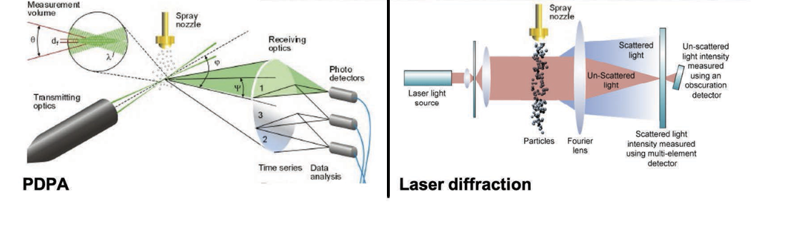
2. Phase Doppler Particle Analysis (PDPA):
Uses laser beams to measure velocity and droplet size via Doppler signals.
Accurate for temporal distributions (flux and velocity).
Errors possible with inhomogeneous droplets (e.g., internal air inclusions)
Notes:
Two laser beams are focused to intersect, creating a measurement zone.
When a droplet passes through this zone, it scatters light.
The phase shift between the scattered light signals, detected by multiple sensors, is proportional to the droplet’s diameter.

Slide 6
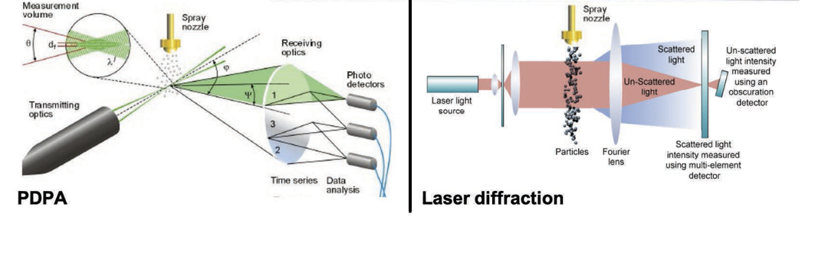
Laser Diffraction:
Measures diffraction angle to estimate droplet size (Mie or Fraunhofer theory).
Assumes spherical droplets; effective for spatial distributions.
High precision, wide range, and repeatable results.
Notes:
A laser beam is directed at the spray.
Droplets scatter the light, creating diffraction patterns.
The angle of diffraction is inversely proportional to the droplet size.

Slide 7
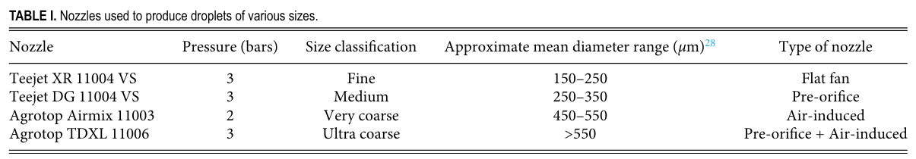
Experimental Setup
Nozzles Used:
Four types to vary droplet size (Fine, Medium, Very Coarse, Ultra Coarse).
Range: 10 μm to 2000 μm.
Liquids:
Water and polymer surfactant solutions.
Measurement Distance:
40 cm below the nozzle.

Slide 8
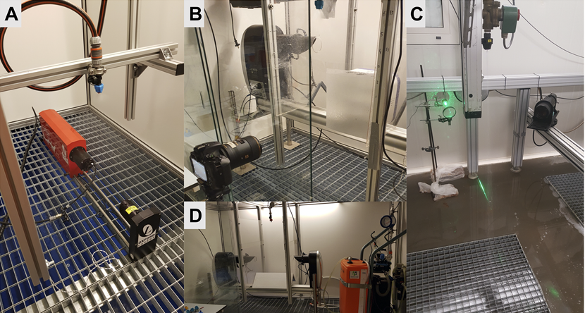
Image Analysis Technique: Setup
Uses light to create droplet images.
Software analyzes snapshots for size and velocity.
Instruments: Oxford VisiSizer (A) and in-house stroboscopic imaging (B).

Slide 9
Phase Doppler Particle Analysis (PDPA)
Uses laser beams to detect droplet size and velocity.
Based on light scattering and Doppler effect.
Measures temporal distribution. High precision for spherical droplets.

Slide 10
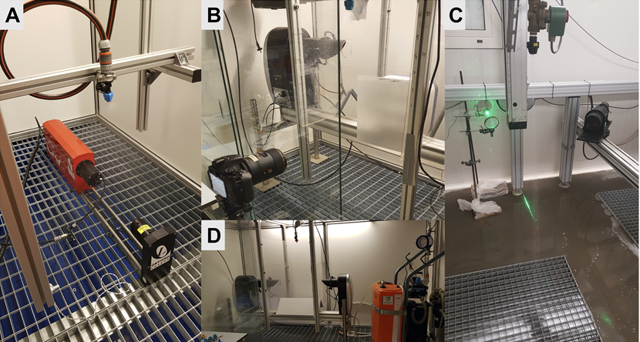
Laser Diffraction Technique
Laser diffraction pattern correlates with droplet size.
Assumes spherical shape using Mie theory.

Slide 11
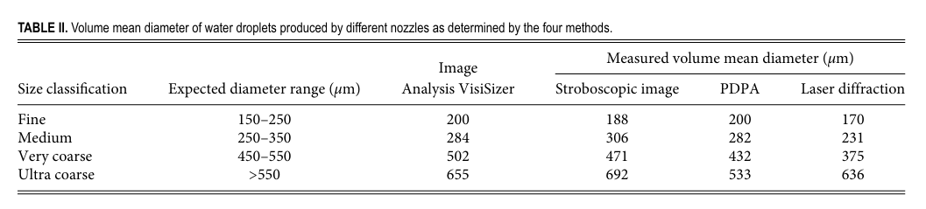
RESULTS AND DISCUSSION
Volume Mean Diameter: Determined for all nozzle classifications using Image Analysis, PDPA, and Laser Diffraction.

Slide 12
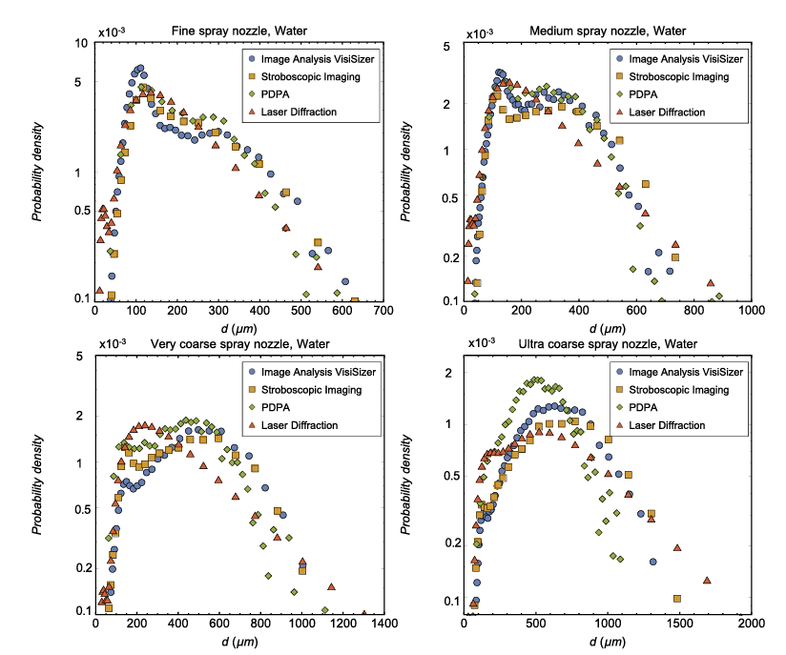

Observations:
Fine Droplets: Measurements across all methods are consistent.
Large Droplets: Significant deviations occur in the tail of the distribution.
Larger droplets contribute to a large volume fraction hence influence VMD.
Notes:
Droplet Size Distributions: Presented as probability density distributions by volume.
Correction applied for bin size due to exponential bin scaling:Larger bins for larger droplets.
Normalized to produce probability density distribution of droplet sizes.

Slide 13
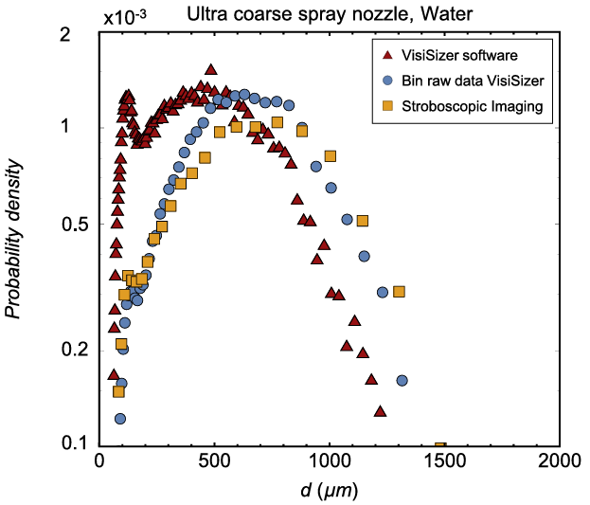
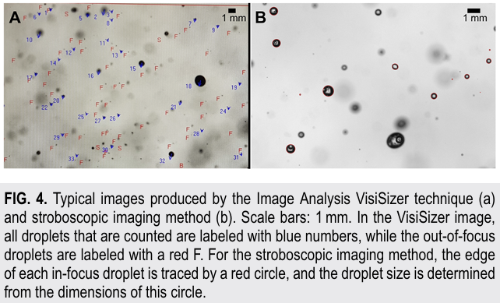
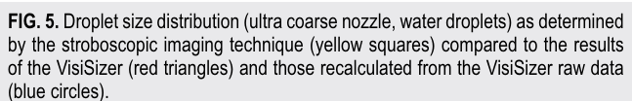
Comparison: VisiSizer vs. Stroboscopic Imaging
Both methods capture droplet images and analyze sizes.
Two distributions from VisiSizer:
Software-calculated distribution.
Raw data distribution (manually binned).
Findings:
VisiSizer software output deviates significantly across all droplet sizes.
Raw VisiSizer data aligns closely with stroboscopic imaging results
Notes:
VisiSizer software may apply corrections that skew results. For analysis in this study, raw VisiSizer data is used for accuracy.

Slide 14
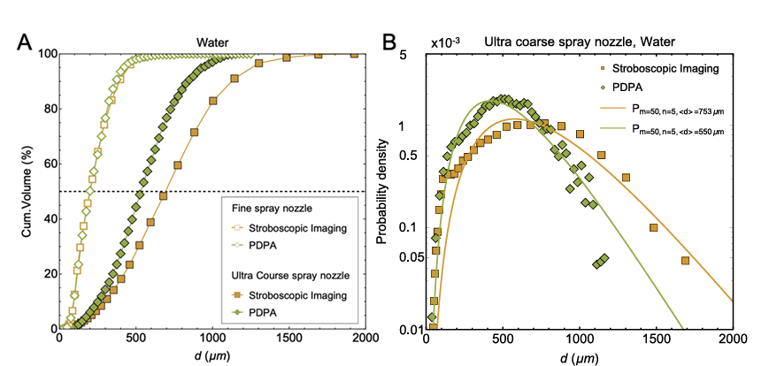
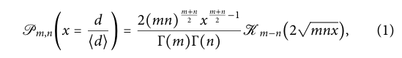

Comparison: PDPA vs. Stroboscopic Imaging
Notes:
One reason for this deviation might be that the working
principle of PDPA is based on the assumption of spherical droplets.
However, large drops (>1000 μm) may not be spherical but at best
ellipsoidally shaped. This means that these drops could be misinterpreted, depending on which part of the drop the effective radius
is measured. Thus, large drops may be interpreted as smaller ones,
while other signals of large drops may be considered inconclusive by
the processing software and hence discarded.
this shifts the cumulative droplet volume percent
age to smaller droplet sizes because droplets between 1000 μm and
1500 μm weigh heavily in the cumulative volume.

Slide 15
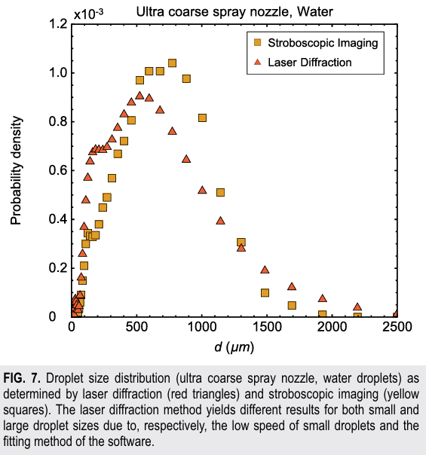
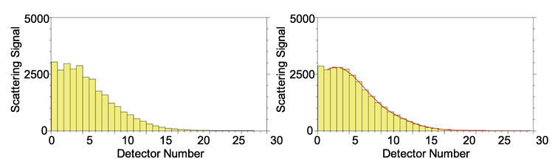
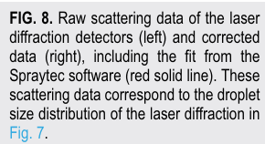
Comparison: Laser Diffraction vs. Stroboscopic Imaging
Size distribution obtained from the laser diffraction method deviates for both small and large droplet sizes compare to Stroboscopic Imaging.
Both methods overestimate small droplets population, resulting in peak at small droplet sizes.
This is because both use spatial distribution, and slow-moving small droplets appear in higher concentration in the sample volume.
Deviation for large droplets is due to fitting method of the Spraytech.
Analysis of or raw images reveal no droplets greater than 1700 μm but Spraytech Software make correction by assuming/creating droplets larger than 1700 μm to meet expected shape of distribution(fitting).F.g 8.
Raw scattered Data
Fit-corrected data
Notes:
"overestimate" means that both the laser diffraction and stroboscopic imaging methods report a higher concentration of small droplets than actually exist in the spray.
This happens because:
Both techniques measure spatial distributions over a given time frame.
Small droplets moving at slower speeds remain in the measurement zone longer, creating the illusion of a higher number or concentration of such droplets.
(In simpler terms, the measurement methods "count" the small droplets more often than they should, leading to a peak in the size distribution at smaller droplet sizes.)
2. fitting method: If the raw data does not align with the expected shape, the software modifies (or "fits") the data to match the assumption.
For example, in this case, the software "creates" droplets larger than 1700 μm because it expects the distribution to include larger droplets.
‘’ In short, the fitting method is the software's way of interpreting and adjusting the raw data to produce a final droplet size distribution that matches its built-in expectations or models.’’

Slide 16
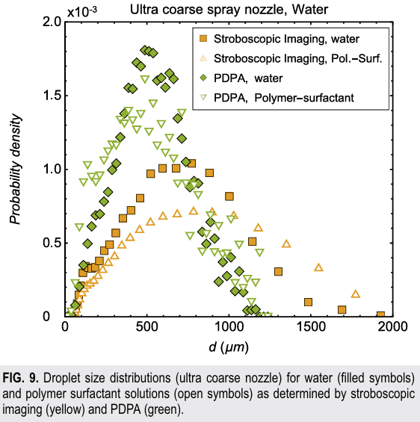
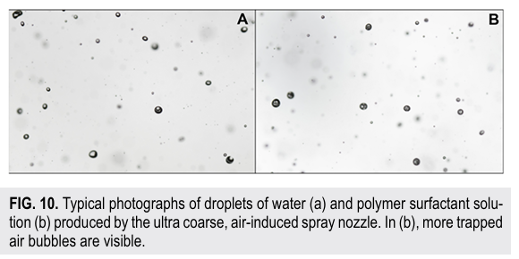
Distorted Droplet Distributions: Polymer Surfactant Effects
Homogeneous Water Sprays vs. Polymer Surfactant Solutions.
Investigate the effect of non-homogeneous droplets on PDPA method, since this technique requires droplets to be transparent and homogeneous.
Long-Chain Polyethylene is used.
Addition of Surfactants causes shift in distribution to smaller sizes having extra peak around d=150 μm.
Combination of surfactants and air-induces nozzle causes air to become trapped inside the droplets.
The refracted signal from the Liquid –air interface is misinterpreted by the detector as coming from smaller droplets.

Slide 17
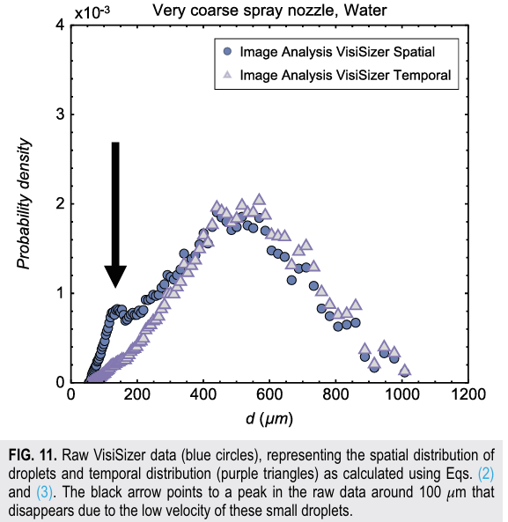
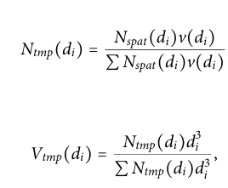
Difference Between Spatial and Temporal Distributions:
Spatial Distributions: Snapshot-based, represents droplet sizes within a specific volume at a given moment.
Produced by Spraytec and imaging techniques.
Temporal Distributions: Time-based: Represents the flux of droplets passing through a measurement area.
Produced by PDPA
Conversion Between Distributions:
Slow-moving droplets are overrepresented in spatial data due to longer residence time.
Ntmp = Temporal droplet count
Vtmp = Temporal Volune %age
v = Avg. Velocity of droplets of size di
The peak around 100 μm disappeared after conversion
Temporal data aligned better with expected distributions.

Slide 18
CONCLUSION:
For smaller droplets, the three techniques generally agree well.
For larger or non-spherical droplets, image analysis techniques, especially stroboscopic imaging, are more reliable.
PDPA and laser diffraction have specific limitations that must be considered when choosing a method.
Notes:
VisiSizer and Stroboscopic Imaging: Both techniques are based on image analysis principles. When using raw data from VisiSizer, results align well with stroboscopic imaging. However, VisiSizer software applies corrections, which leads to different results.
These methods are effective for measuring droplets up to about 400 μm.
Phase Doppler Particle Analysis (PDPA): PDPA requires droplets to be homogeneous, transparent, and spherical. For inhomogeneous drops this technique may misinterpret droplet sizes.
Laser Diffraction: Uses a fitting method that can cause misinterpretation if the droplet size distribution deviates from the expected shape.
Overestimate the contribution of small droplets due to their low velocity, results in a higher concentration of small droplets in the sample volume.

Slide 19
THANK YOU

